Slide 1

GUIDE SELECTION PROJECT
SATHYABAMA INSTITUTE OF SCIENCE AND TECHNOLOGY
PROJECT MENTOR:
Dr. ALBERT J MAYAN M.E., Ph.D.,
STUDENT NAME:
JAGADEESH N
REG NO: 39110393

Slide 2
ABSTRACT:
This Application is a web based portal, which allows the student to register themselves and select their guide for the final year project.
This is an inhouse project given by the department of CSE.
The student can register his team using email, Name, project details like project Name, Project Domain, Project Description.
The student can then select the guide based on the available vacancy to the guide and the details of his/her team will be mailed via SMTP protocol to the student(s) containing the project details.
Upon registering the team, student(s) cannot login again to avoid duplicates and not to change his choice of guide.

Slide 3
INTRODUCTION:
The Student Project and Guide Registration System is an web based portal.
It can be used by educational institutes or colleges to maintain the projects of students easily.
This Portal allows online submission of student Project details and selection of the guide.
Achieving this objective is difficult using a manual system as the information is scattered, can be redundant and collecting relevant information may be very time consuming.
This Portal will store the details of the students such as student details, Project details, guide selected, guide details.

Slide 4
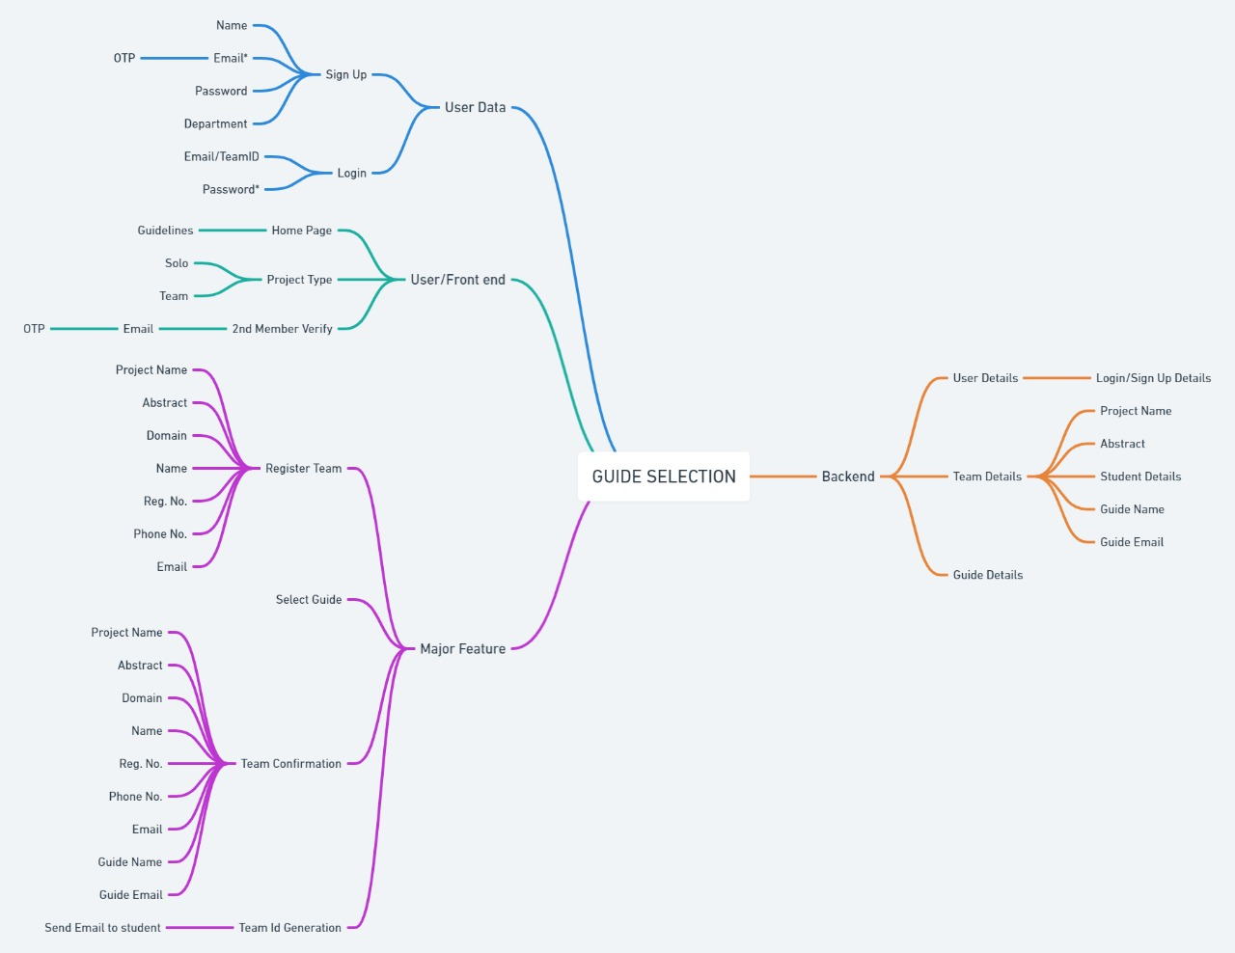
IDEATION MAP:

Slide 5
MODULES:
Psycopg2:- A plugin for connecting backend Django with postgresql database and performing the query operation.
Send_email():- A Django.email plugin to send auto-generated email from the server to the user regarding the status of his/her submission.
Django-Heroku:- A Heroku plugin for connecting the Heroku cloud base with our local Application.
Gunicorn:- Determines what type of Web Application it is i.e. identifies it as WSGI(Web Server Gateway Interface) or ASGI (Asynchronous Server Gateway Interface) and acts as a medium to serve requests from Heroku cloud server to web application in the backend.

Slide 6
Deployed Link
https://www.cse-projectregistration.co.in/

Slide 7
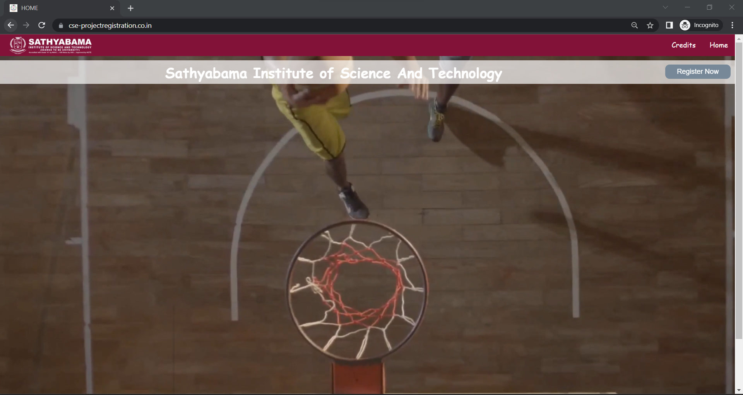
APPLICATION SCREEN SHOT:

Slide 8
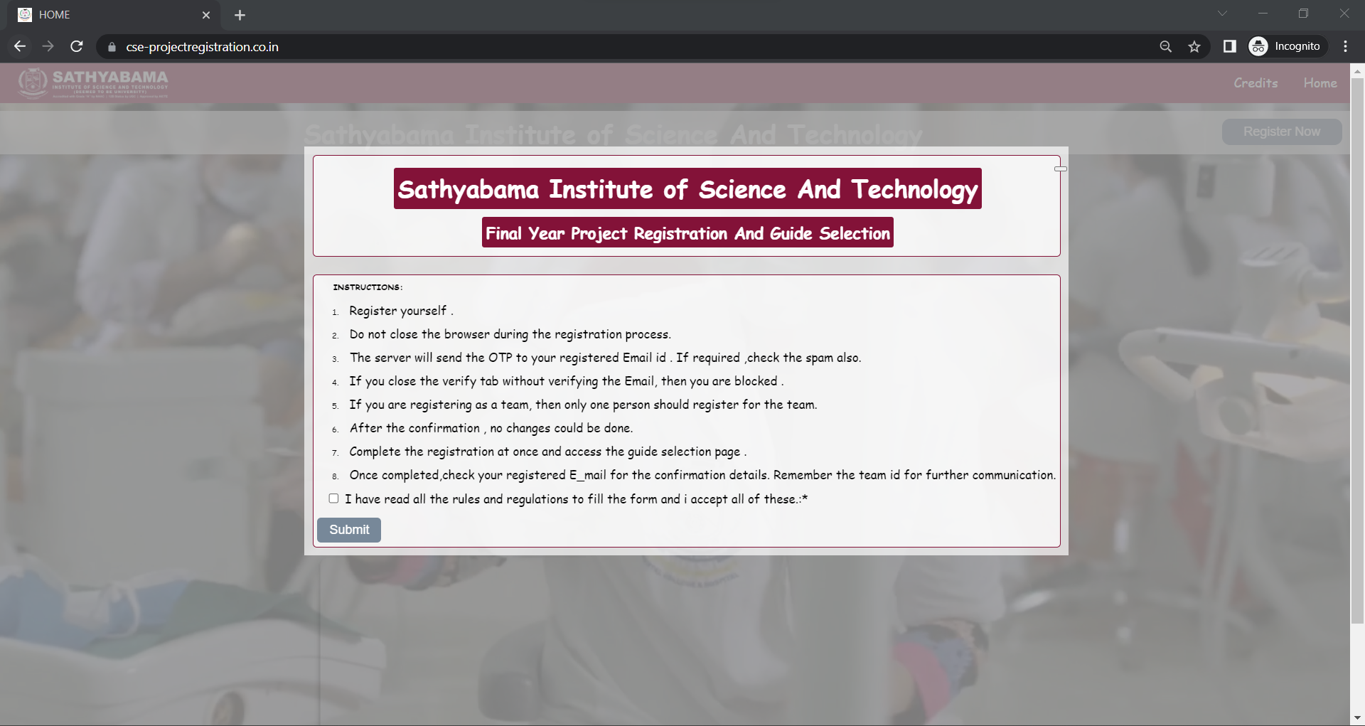

Slide 9
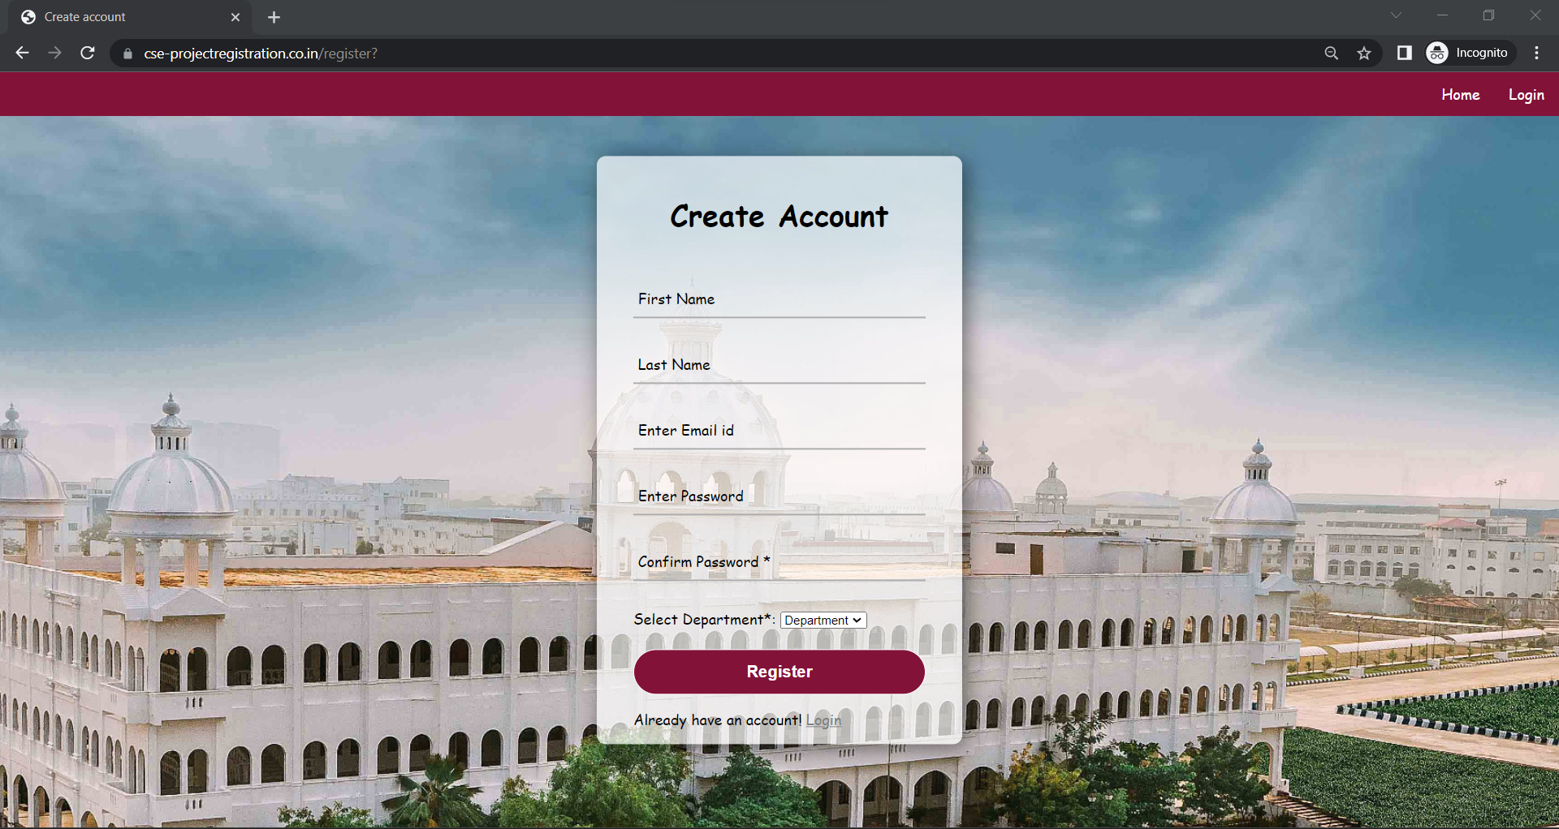

Slide 10
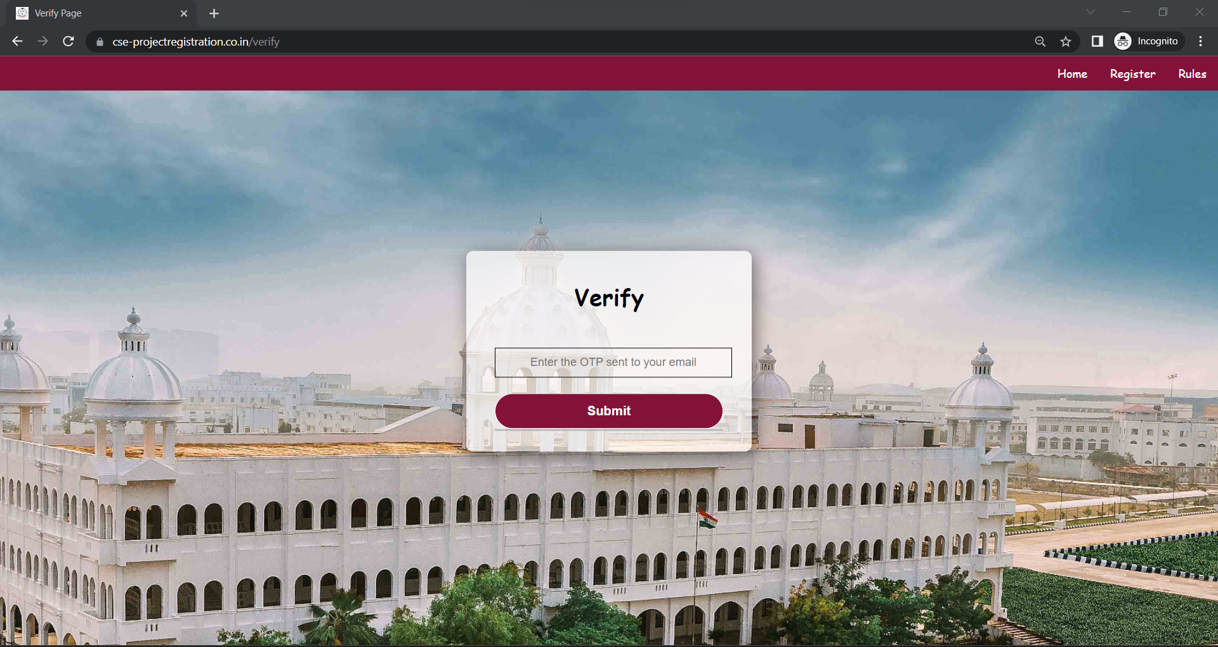

Slide 11
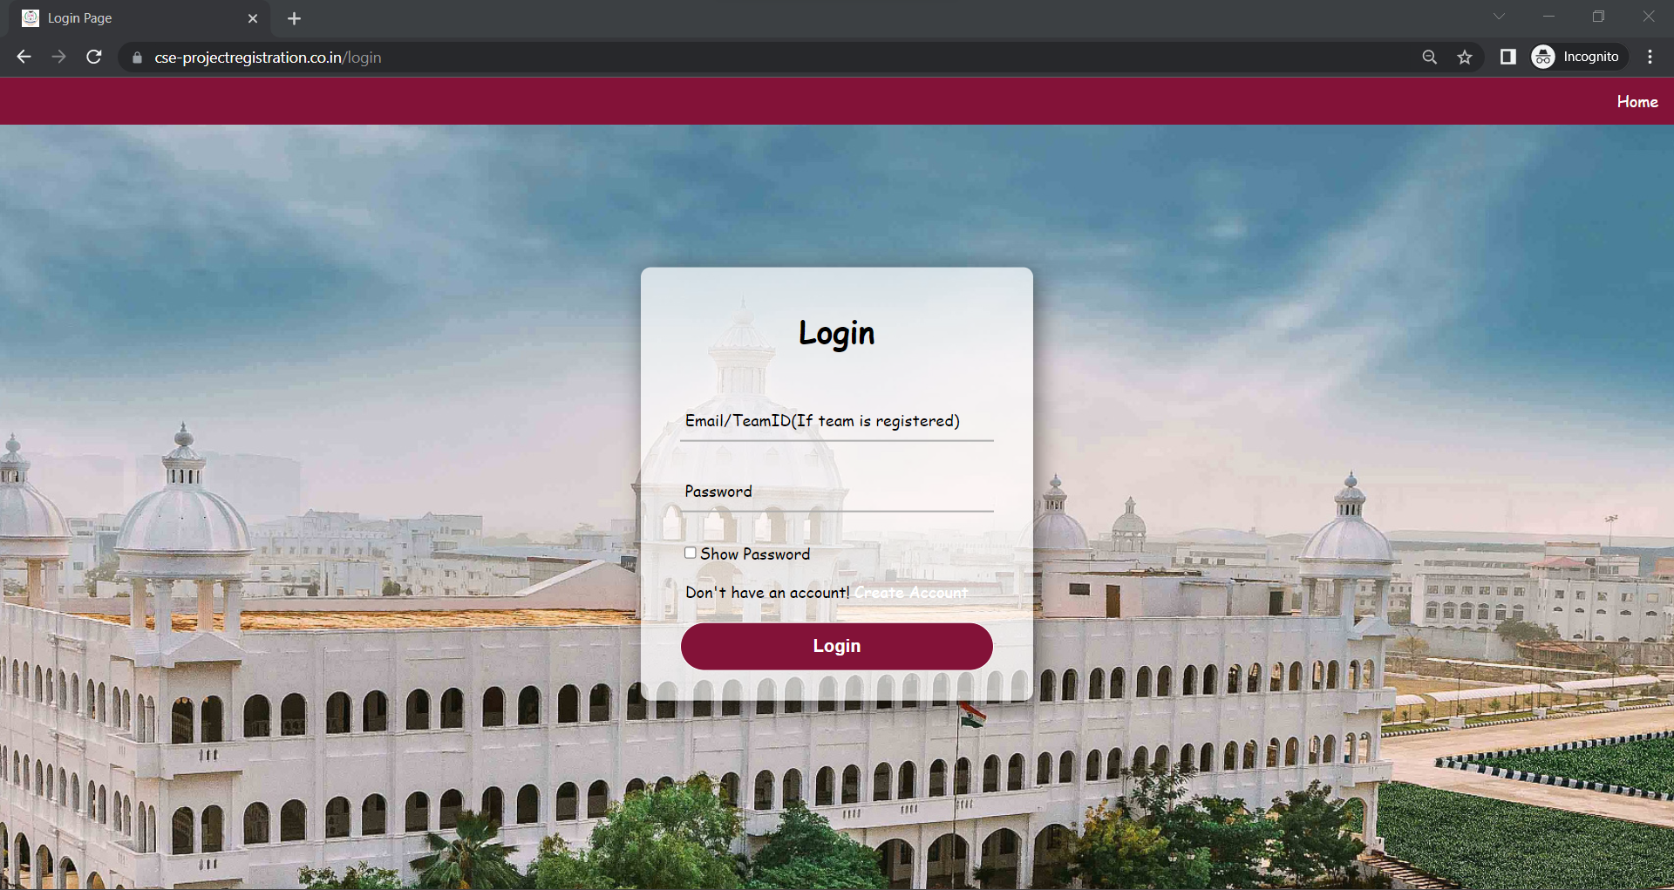

Slide 12
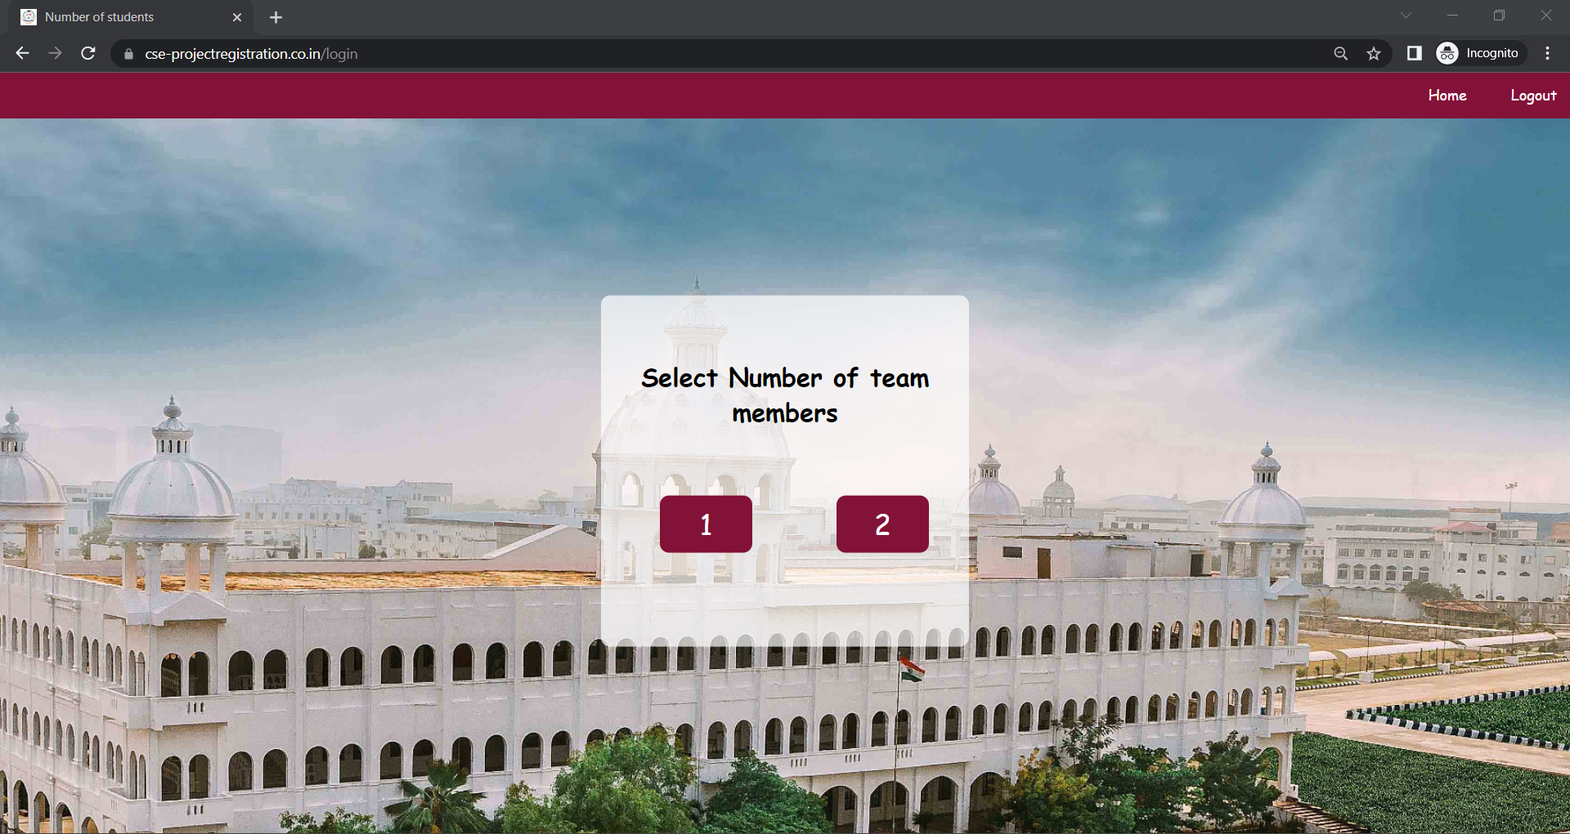

Slide 13
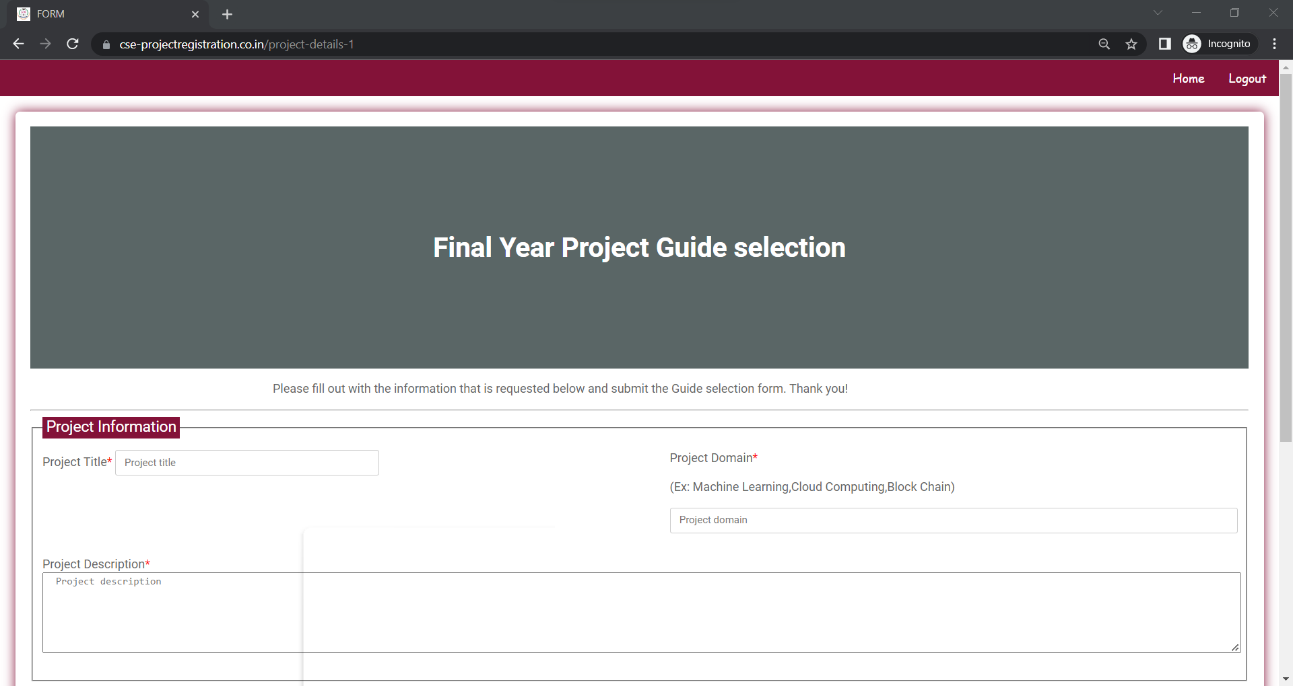
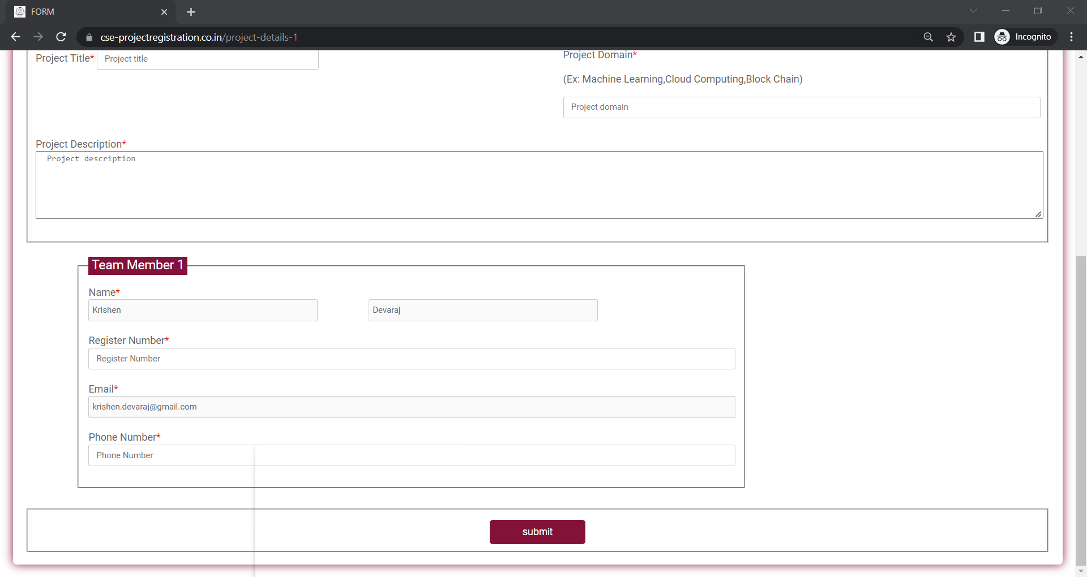

Slide 14
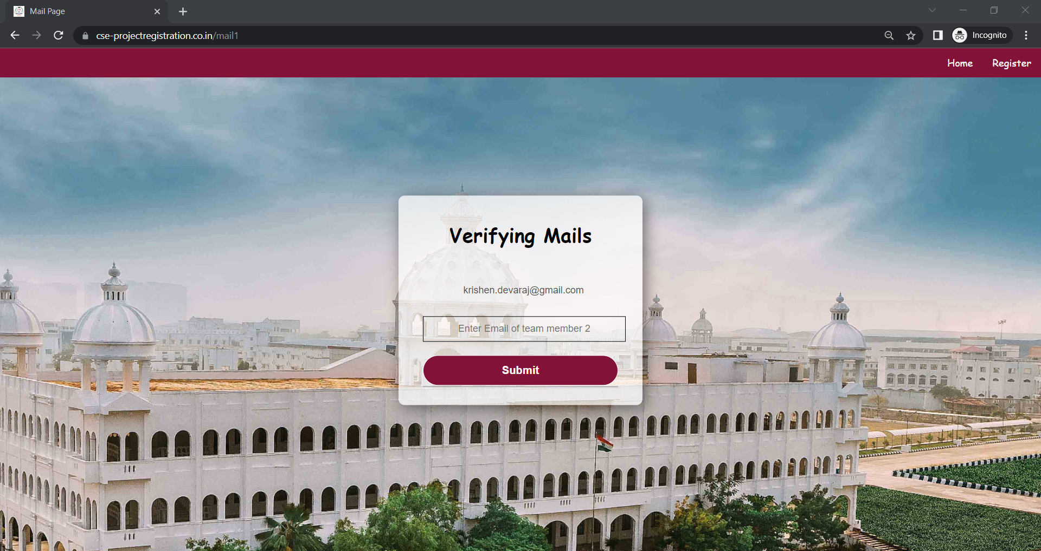
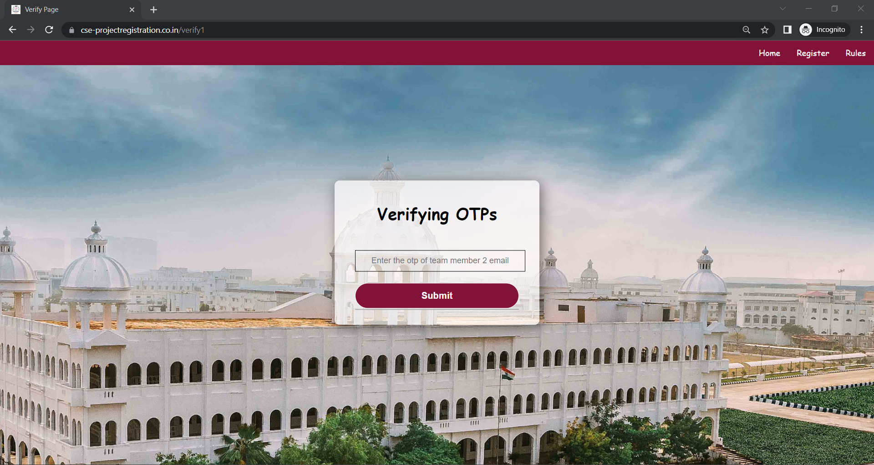
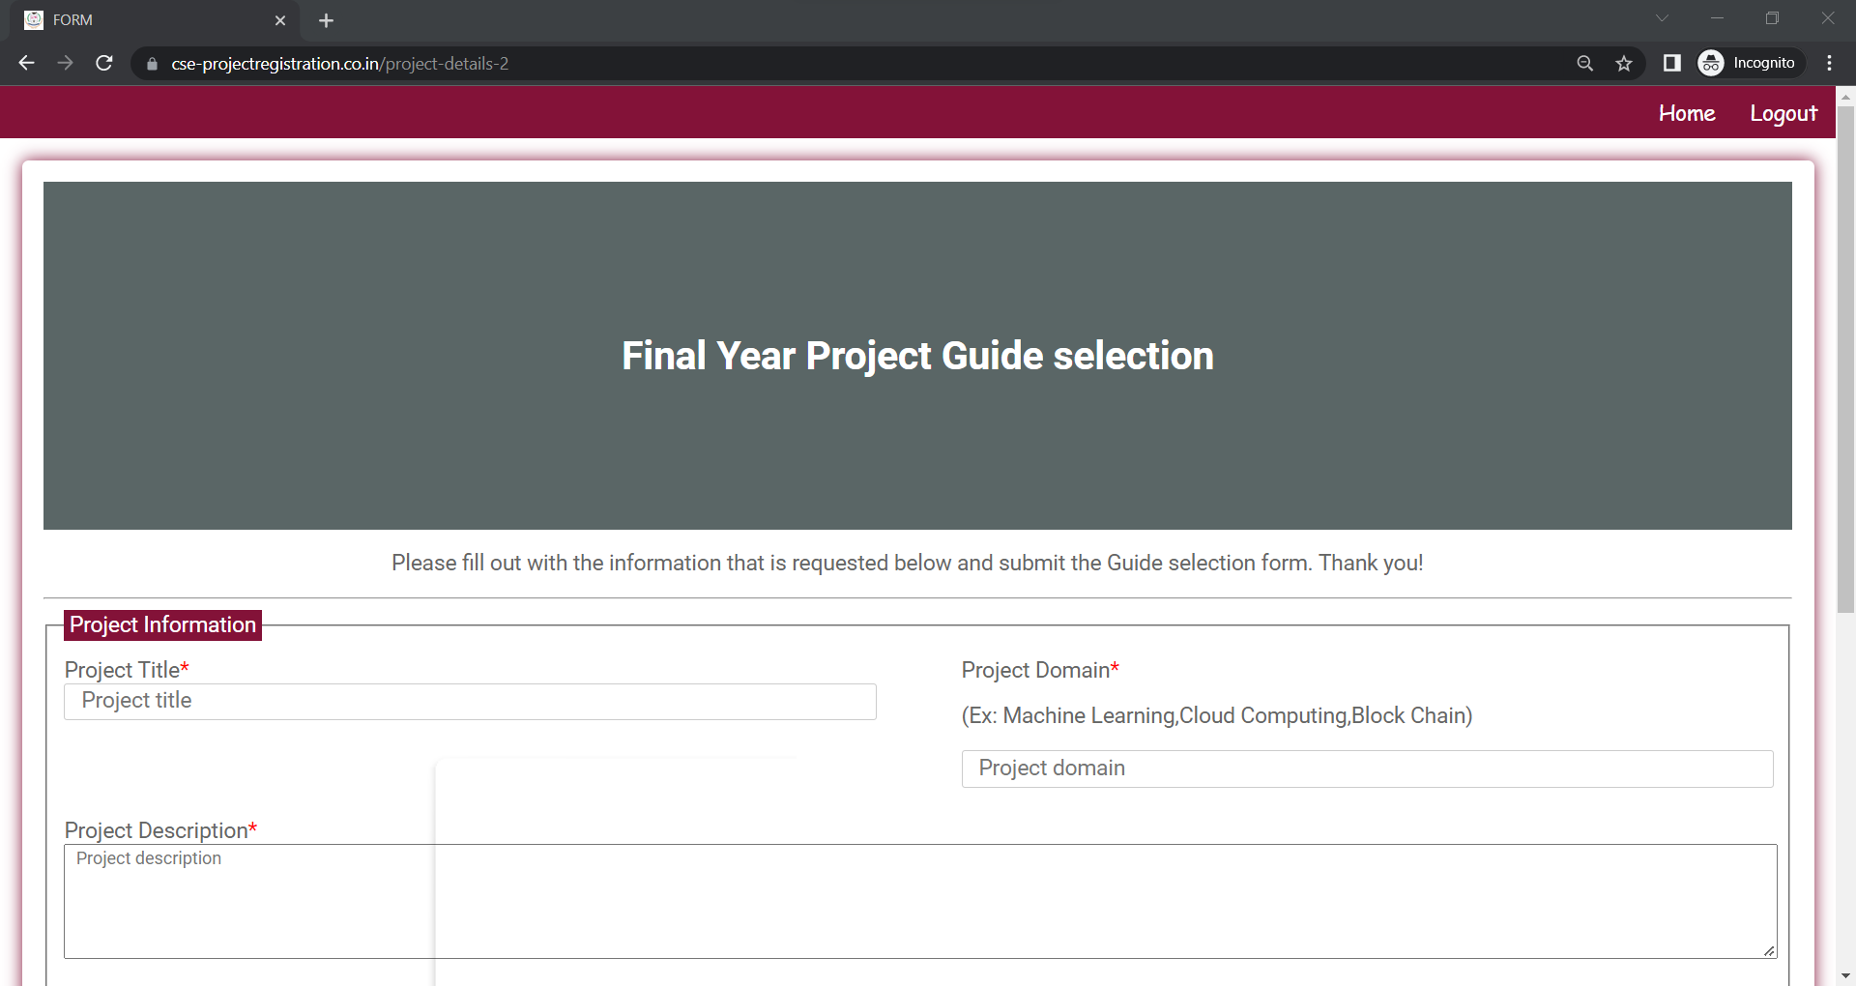
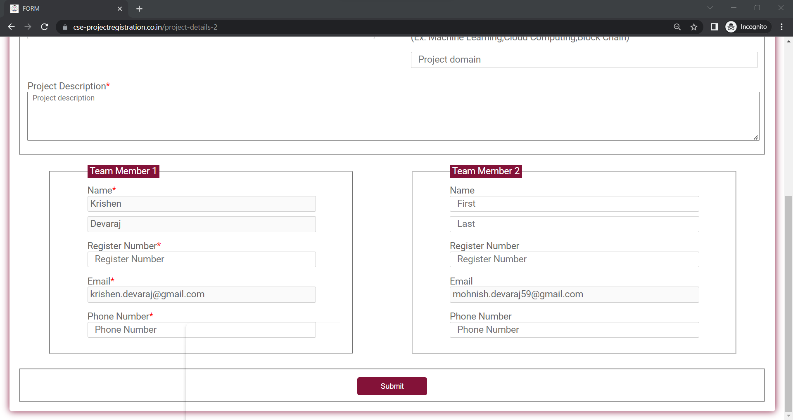

Slide 15
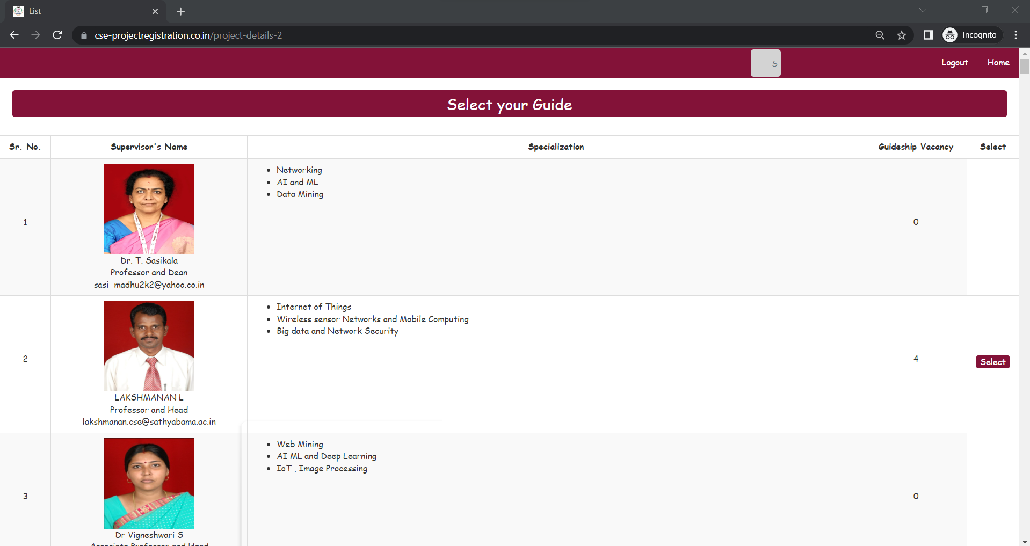

Slide 16
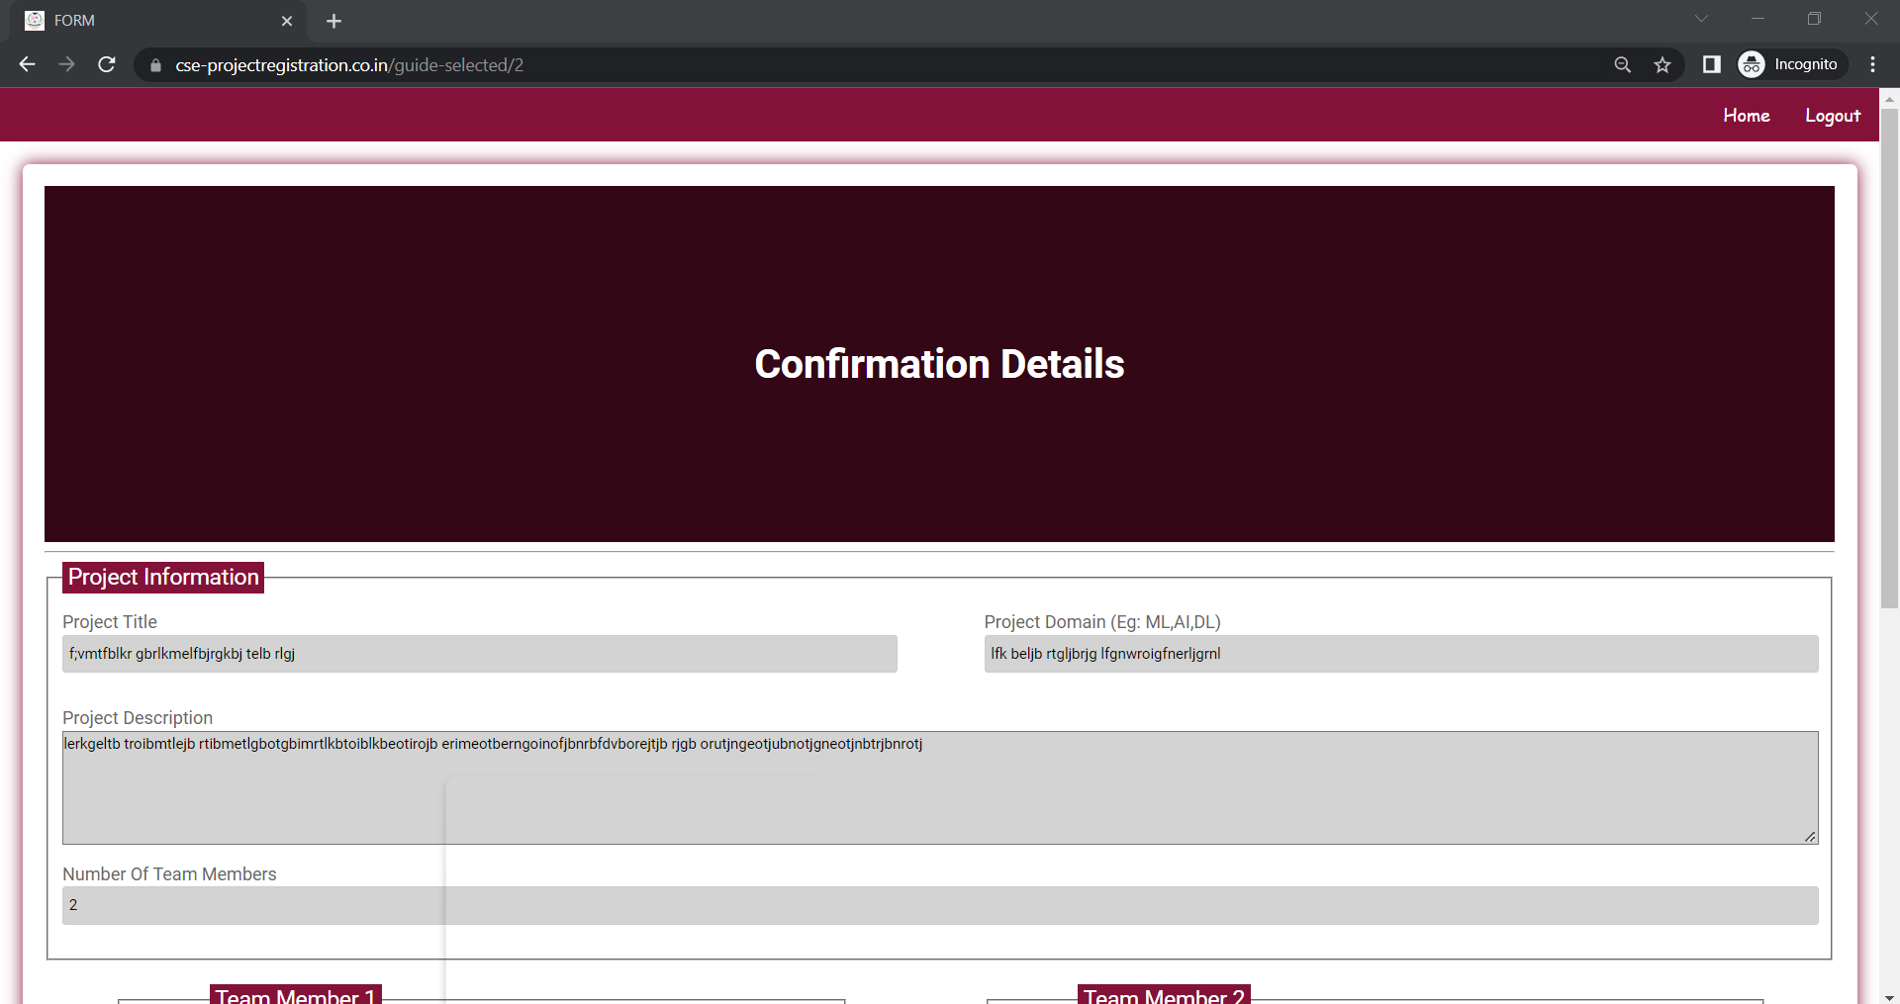
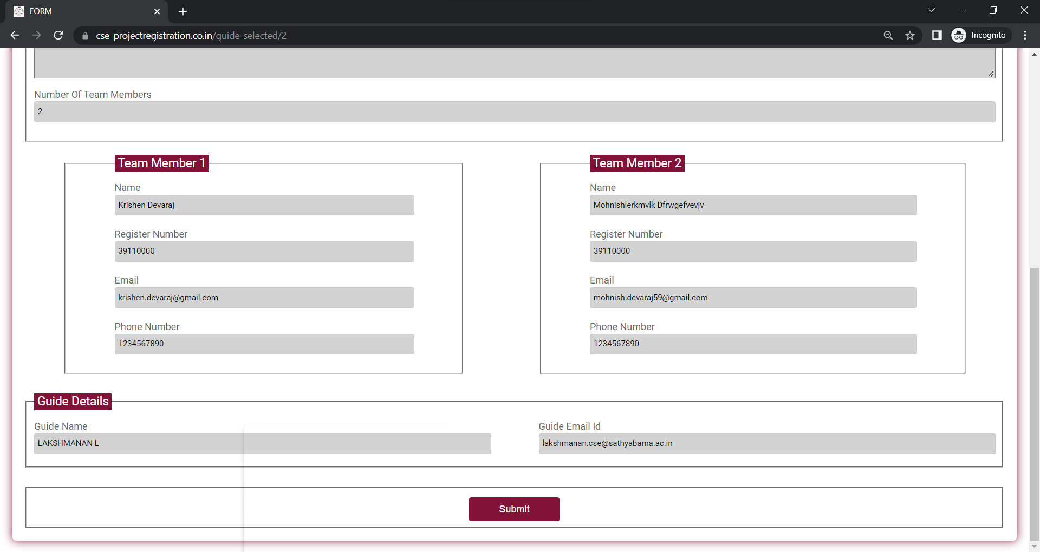

Slide 17
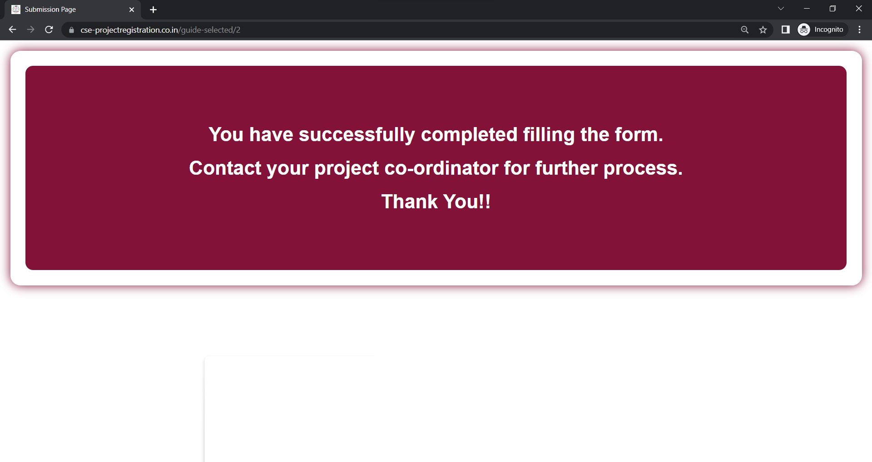

Slide 18
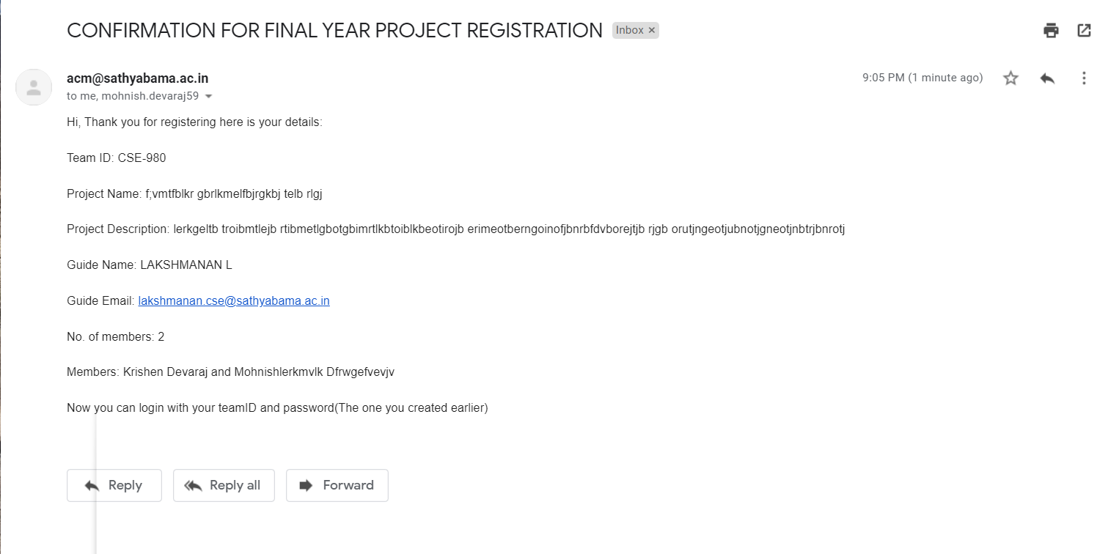

Slide 19


